Slide 1
Chaffers CLASS 2023-24 Welcome

Slide 2
CHAFFERS CLASS STAFF
Monday and Tuesday – Mrs Chevallier
Wednesday, Thursday and Friday – Mrs McAlpine
Mrs Simmons- Monday and Friday
Mrs Kolisnyk-Tuesday, Wednesday and Thursday
Mrs Arturi -PPA cover

Slide 3
ROUTINES
Orange book, coat, water bottles every day please.
Pencil case- scissors, glue (small enough to fit in tray).
PE- Tuesday and Friday .
Independence – encourage your child to be responsible for their belongings and organise themselves
Concerns – don’t wait please talk to us.

Slide 4
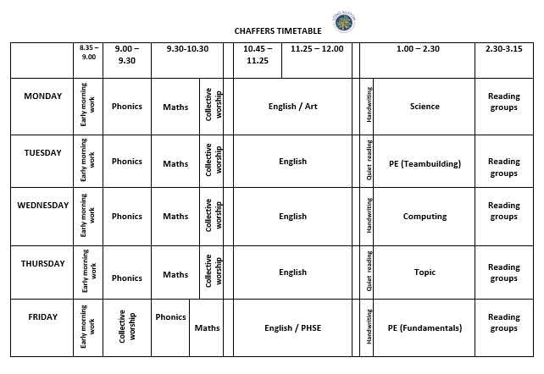

Slide 5
Year 1 and 2 | AUTUMN
2023-4 | Maps and me Superheroes
Science | Animals including Humans
Computing | Digital Literacy-online safety Maze explorers
History | Florence Nightingale
Geography | Maps and me
Art | Self portraits
DT | Textiles-making and evaluating a Christmas decoration
PE | Team Building Fundamentals
RE | Hinduism- creation stories Christianity-Incarnation
Music | Singing games The Nativity.
PHSE | ‘Get Heartsmart’ ‘ Don’t forget to let love in’

Slide 6
ASSESSMENT
Benchmarking
O Track- Ongoing assessment against milestones
Parent’s evening
SATs for Y2s- Teacher assessment

Slide 7
HOMEWORK
Reading - Recorded in orange reading, spelling and vocabulary journal.
Spellings - From Spelling Shed
Number bond pond tested on Fridays- level in orange book.
My Maths – Set on a Friday to be completed by the following Friday.
Handwriting- Letter-join log in.
All logins in orange book

Slide 8
WAYS TO HELP
Read the weekly newsletter
Try to make doctors/dentist/optician appointments after school or in the holidays
Encourage your child to do their homework as independently as possible
Talk to us at the first sign of any problem Name everything

Slide 9
THANK YOU FOR COMING
Any questions?

